Slide 1

ECEN 3593-001 Computer Organization
Lecture #11
10 February 2021

Slide 2


Agenda
Class Announcements
Course Project Questions
Begin Chapter 4

Slide 3
Class Announcements
Reading for the week
“Computer Organization and Design, The Hardware / Software Interface, RISC-V edition,” by David Patterson and John Hennessy
ISBN 978-0-12-812275-4
Chapter 4, “The Processor”
pages 236-314 (sections 4.1 thru 4.8)
I will have OH today from 2:00 to 3:00, but I will not have my Zoom meeting open. Send Slack if you want to talk and I will start it within 10 minutes.

Slide 4
Class Announcements
Phase 3 Target Date Sunday, February 14 at 10:00 PM
Phase 4 will be posted tonight
Target Date Sunday, February 21 at 10:00 PM
Homework #1A due tomorrow, February 11 at 10:00 PM
Homework #2 is posted, due February 18 at 10:00 PM

Slide 5

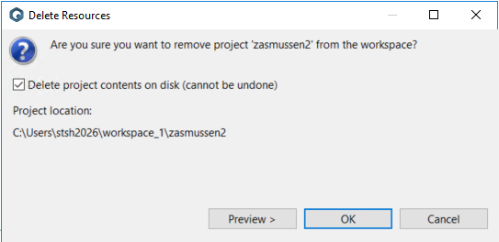
Class Project
You can re-execute the previous Run -> Debug Configurations by clicking on the Bug in the ribbon.
If you delete a project, be sure to check “Delete on disk”.
Export the project to H: if you will need it later.
This is a way to back up!!

Slide 6
Phase 3
I will periodically post some “Hint of the Day” documents on Slack, and post periodic running compilations of them in the Phase 3 section of Canvas.
These are often based on questions I get in Slack and OH.
Questions?

Slide 7
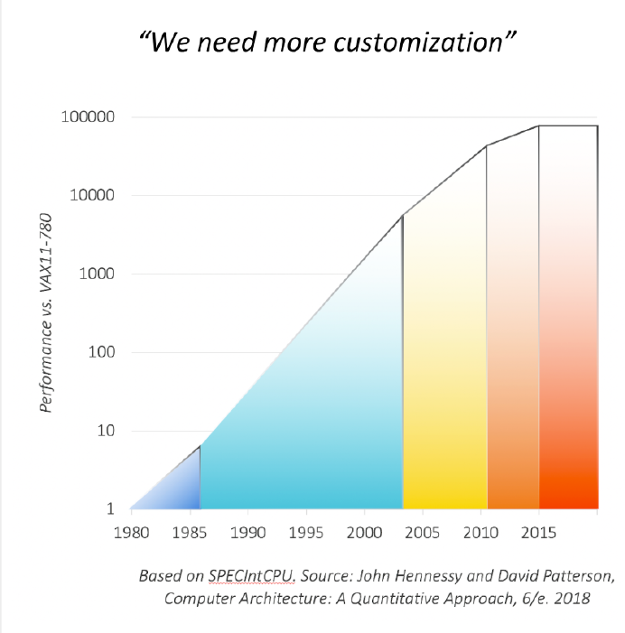
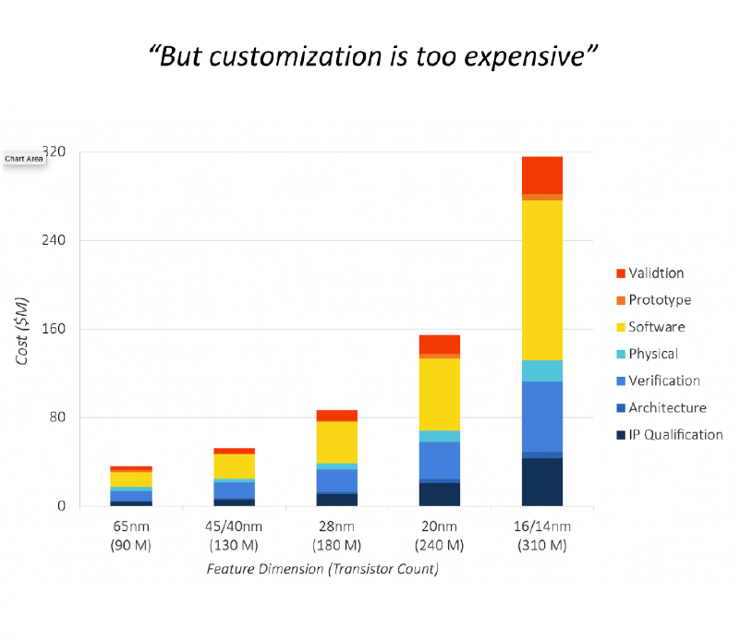

RISC-V Meetup Slides

Slide 8
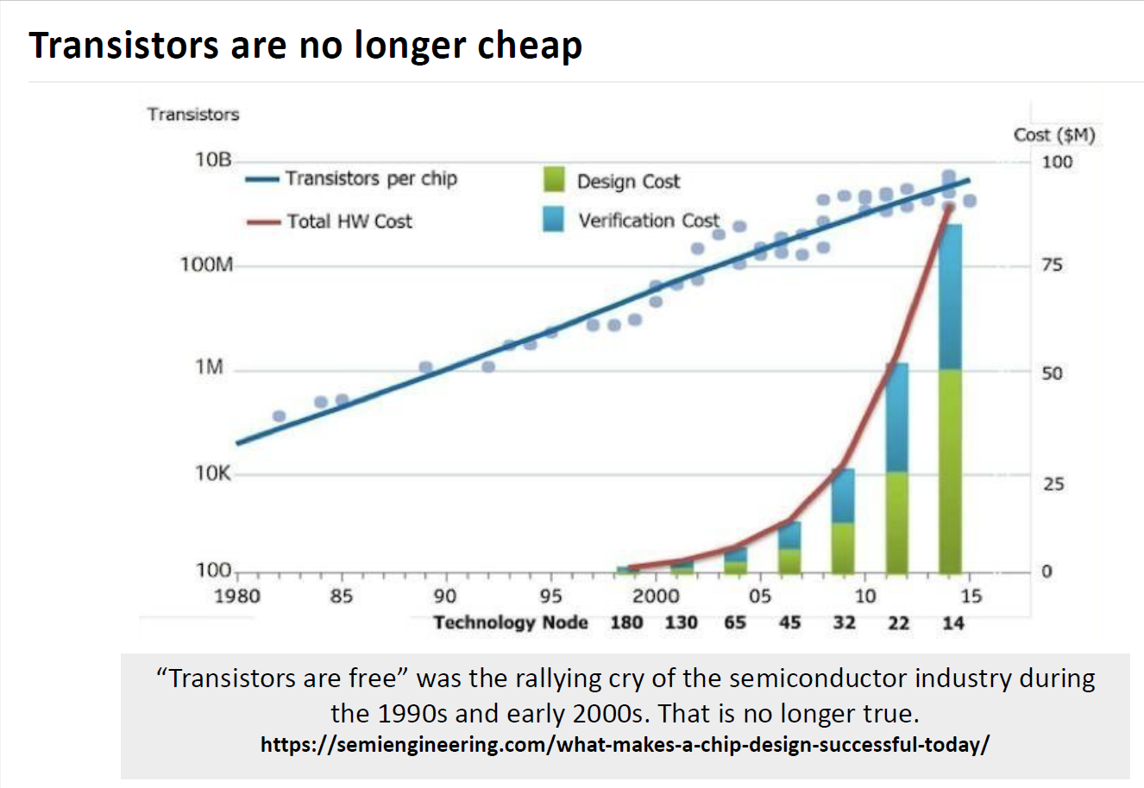
RISC-V Meetup Slides

Slide 9
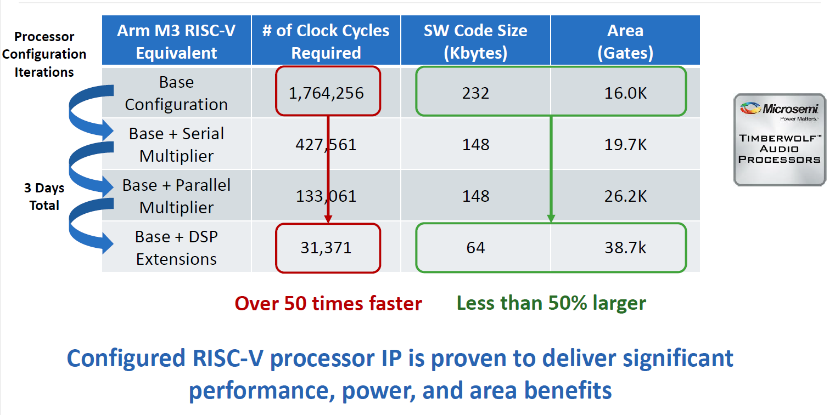
RISC-V Meetup Slides

Slide 10
Chapter 2 concluding remarks
Design principles
Simplicity favors regularity
Smaller is faster
Good design demands good compromises
Make the common case fast
Layers of software/hardware - Abstraction
Compiler, assembler, hardware
RISC-V: typical of RISC ISAs

Slide 11
Chapter 4: The Processor
CPU performance factors
Instruction count
Determined by ISA and compiler
CPI (Clocks per Instruction) and Cycle time
Determined by CPU hardware
We will examine two RISC-V implementations
A simplified version
A more realistic pipelined version
Simple subset, shows most aspects
Memory reference (64-bit data path): ld, sd
Arithmetic/logical: add, sub, and, or
Control transfer: beq
The course project will be focusing on the more realistic pipelined version

Slide 12
Executing an Instruction
PC → instruction memory, fetch instruction
Register selects → register file, read registers
Depending on instruction class
Use ALU to calculate
Arithmetic result
Memory address for load/store
Branch decision
Access data memory for load/store
Update PC ← target address or PC + 4

Slide 13
CPU Overview
Send PC to Instruction Memory
Read instruction
Read Register File -> ALU
ALU Output written to RF
Immediate to ALU
Address to Data Memory
Write data to Data Memory
Read data written to RF
PC normally incremented by 4
PC, branch offset to adder
Branch address to PC
4 Instruction Types
Arithmetic
Load
Store
Branch
4
ADD
ADD
Instruction Memory
din
Register File
ALU
addr
dout
PC
rd
dout1
addr
instr
Data Memory
rs1
dout2
rs2
din

Slide 14
CPU Overview - Choices
4 Instruction Types
Arithmetic
Load
Store
Branch
4
ADD
ADD
Instruction Memory
din
Register File
ALU
addr
dout
PC
rd
dout1
addr
instr
Data Memory
rs1
dout2
rs2
din

Slide 15
Logic Design Basics
Information encoded in binary
Low voltage = 0, High voltage = 1 (also referred to as set or assert)
One wire per bit
Multi-bit data encoded on multi-wire buses
Combinational or Combinatorial element
Operate on data
Output is a function of input
Given the same inputs, will always generate the same output because it has no internal storage

Slide 16
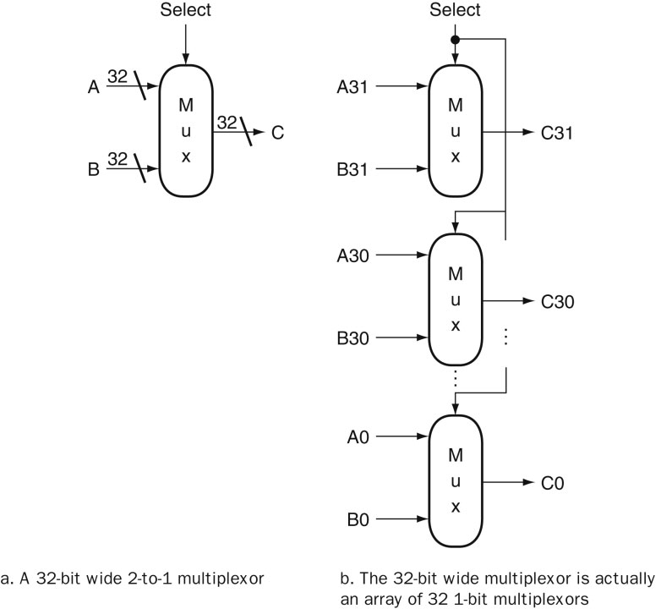
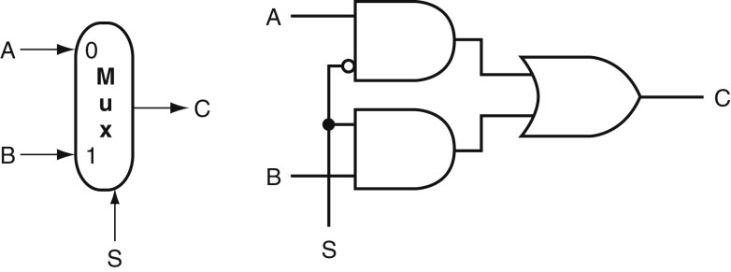
Multiplexor
NOT
AND
OR

Slide 17
Combinational Elements
AND-gate
Y = A & B
Adder
Y = A + B
A
+
Y
B
A
Y
B
Arithmetic/Logic Unit
Y = F(A, B)
Multiplexer
Y = S ? I1 : I0
A
I0
M u x
Y
Y
ALU
I1
B
S
F

Slide 18
CPU Overview - Choices
4 Instruction Types
Arithmetic
Load
Store
Branch
4
ADD
ADD
Instruction Memory
din
Register File
ALU
addr
dout
PC
rd
dout1
addr
instr
Data Memory
rs1
dout2
rs2
din

Slide 19
CPU Overview - Multiplexors
ctrl1
MUX
4
ADD
ctrl3
ADD
ctrl2
MUX
Instruction Memory
din
Register File
ALU
addr
dout
PC
rd
dout1
addr
instr
MUX
Data Memory
rs1
dout2
rs2
din

Slide 20
CPU Overview – Control Signals
ctrl1
MUX
4
ADD
ctrl3
ADD
ctrl2
MUX
Instruction Memory
din
Register File
ALU
addr
dout
PC
rd
dout1
addr
instr
MUX
Data Memory
rs1
dout2
rs2
regwr
memrd
din
memwr
ctrl4
ctrl7
ctrl5
ctrl6

Slide 21
CPU Overview – Control Block
ctrl1
MUX
4
ADD
ctrl3
ADD
ctrl2
MUX
Instruction Memory
din
Register File
ALU
addr
dout
PC
rd
dout1
addr
instr
MUX
Data Memory
rs1
dout2
rs2
regwr
memrd
din
memwr
ctrl4
ctrl7
ctrl5
ctrl6
Control
ctrlX

Slide 22
CPU Overview – Branch
ctrl1
MUX
4
ADD
ctrl3
zero
ADD
ctrl2
MUX
Instruction Memory
din
Register File
ALU
addr
dout
PC
rd
dout1
addr
instr
MUX
Data Memory
rs1
dout2
rs2
regwr
memrd
din
memwr
ctrl4
ctrl7
ctrl5
ctrl6
Control
ctrlX

Slide 23
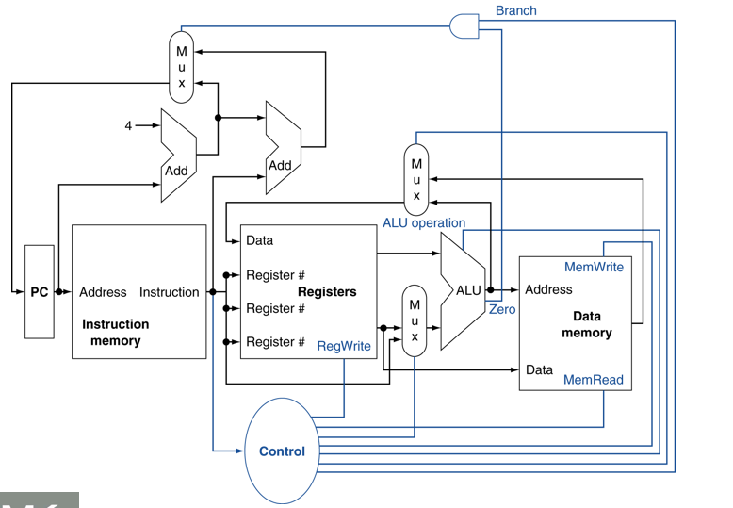
Control Unit
DECODEs the incoming instruction
Directs the flow of the data through the CPU core
Specifies the ALU operation
Decides what the next instruction will be

Slide 24
Definitions
State (sequential) elements
Contains some internal storage
If all the state elements were restored, the CPU could restart from a known position
State elements completely characterize the computer
Has a minimum of 2 inputs (data and clock) and one output (data value written in an earlier clock period)
Data written only on clock edges (either rising or falling)
Data can be read anytime

Slide 25
State (sequential) Elements
Register: stores data in a circuit
Uses a clock signal to determine when to update the stored value
Edge-triggered: update when Clk changes from 0 to 1
Clk
D
Q
D
Clk
Q

Slide 26
CPU Overview – Sequential Elements
ctrl1
MUX
4
ADD
ctrl3
zero
ADD
ctrl2
MUX
Instruction Memory
din
Register File
ALU
addr
dout
PC
rd
dout1
PC
addr
instr
MUX
Data Memory
rs1
dout2
rs2
regwr
memrd
din
memwr
ctrl4
ctrl7
ctrl5
ctrl6
Control
ctrlX

Slide 27
CPU Overview – Sequential Elements
ctrl1
MUX
4
ADD
ctrl3
zero
ADD
ctrl2
Which state elements do not require a control line?
Why?
MUX
Instruction Memory
din
Register File
ALU
addr
dout
PC
rd
dout1
PC
addr
instr
MUX
Data Memory
rs1
dout2
rs2
regwr
memrd
din
memwr
ctrl4
ctrl7
ctrl5
ctrl6
Control
ctrlX

Slide 28
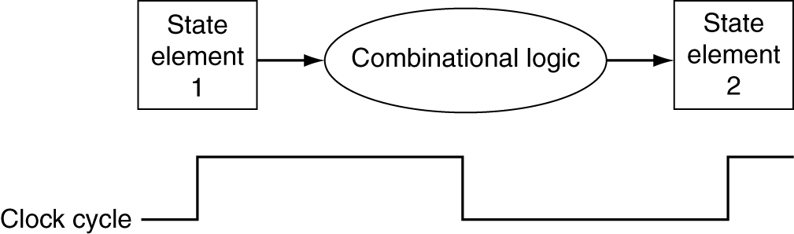
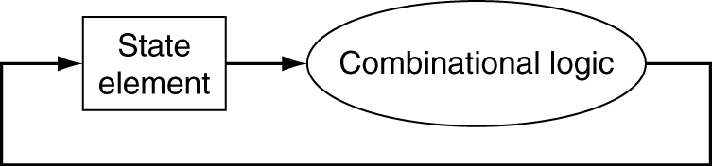
Clocking Methodology
Defines when signals can be read and when they can be written
Combinational logic transforms data during clock cycles
Between clock edges
Input from state elements, output to state element
All sequential elements updated simultaneously

Slide 29
Clocking Methodology
The clocking methodology is designed to make hardware predictable
Clocking can occur on either the rising or falling edge of the clock (edge-triggered clocking)
Clock period is determined by the longest time from state element 1 to propagate to state element 2
The slowest combinational delay sets the clock period and frequency

